Slide 1



K&O Personnel Management Systems
Created by: Jon King, Anthony Orengo

Slide 2


Team
Jon King
Anthony Orengo

Slide 3
About K&O
K&O Personnel Management System is a web-based application that uses a database to access and store user data, so organizations can better track and monitor their employees.

Slide 4
The K&O Mission
“To create a secure and reliable personnel management system for all organizations worldwide”

Slide 5
The K&O Vision
“Efficient and reliable tracking system for all organizations big & small”

Slide 6
Problem
Personnel Management Record Keeping
Employee Progress

Slide 7
Solution
Create a personnel management system that tracks employee in and out times by use of a barcode system.

Slide 8


Technologies Used

Slide 9

Technologies Used
Hardware Technologies
Software Technologies
Coding Languages
Laptop with suitable ports
Projector with accessories
Realinn RL6200 Barcode Scanner
Java Netbeans IDE
SQL Plus
Free MySQL Hosting
Maria DB
Paint 3D
PowerPoint
Adobe Photoshop
Free Logo Design
Java, JSP
SQL
HTML
CSS
Javascript

Slide 10
User Stories

Slide 11
User Stories Cont.
# 1. EPIC - As an administrator, I want to be able to track my employees/student's attendance.
Responsive Webpage: As a user, I want a responsive website, so I can view the website on various devices(laptop, desktop, mobile devices).
ADD MORE

Slide 12
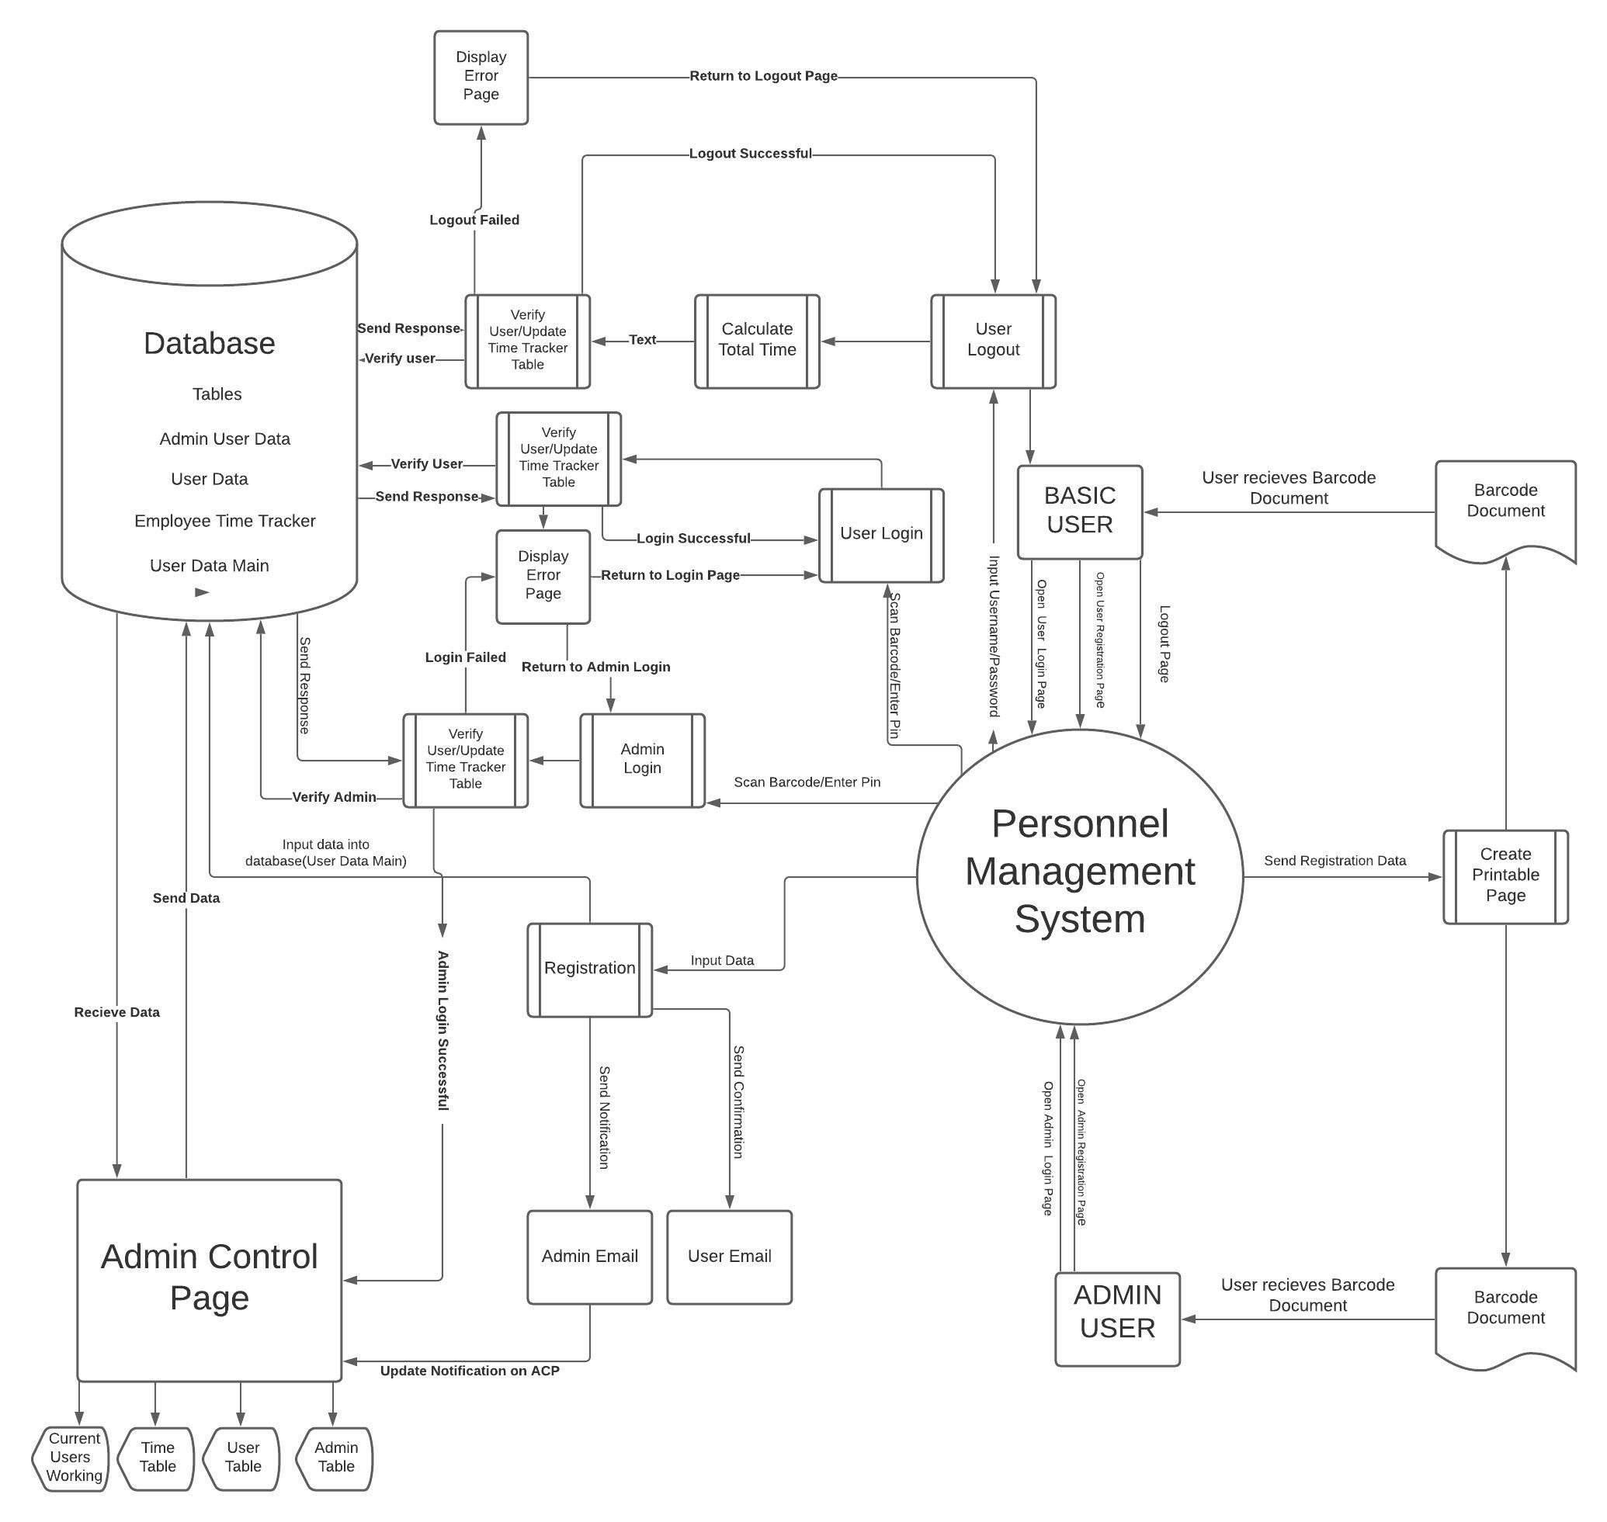
Context Diagram

Slide 13

Application Security

Slide 14
Application Security
Security Methods

Slide 15

Live Demo

Slide 16
Questions?
Created by: Jon King, Anthony Orengo

